Slide 1
5CM524 Functional Programming
Dr Youbing Zhao
Prof Stephan Reiff-Marganiec University of Derby
2025-2026

Slide 2
5CM524 Functional Programming Lecture 1 Welcome, Programming Paradigms, 1st step in FP
Dr Youbing Zhao
Prof Stephan Reiff-Marganiec University of Derby
2025-2026

Slide 3
Today
Some starting notes to the module
A brief review of some programming paradigms
Some basics on Haskell and a look at GHCi
A look at some functions

Slide 4
Welcome
Your teaching team
The course
Blackboard/ Course resources
Expectations
Assessment
Support

Slide 5
A bit Computing Theory
and
Programming Language Paradigms

Slide 6
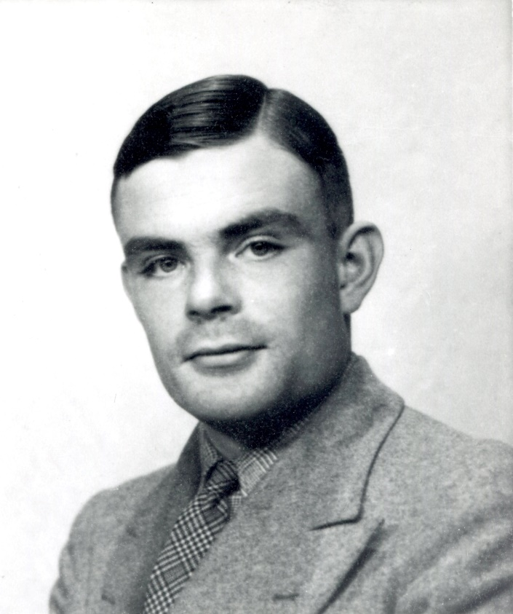
Turing Machine
Proposed by Turing in 1936 to address the computability problem in mathematics
Abstracting the process of performing calculations with pen and paper
Can simulate any operation that can be carried out on a modern computer.

Slide 7
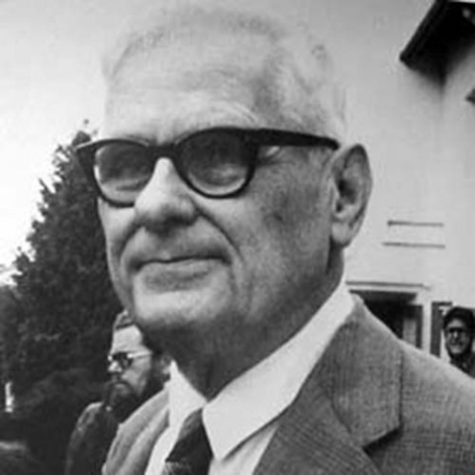
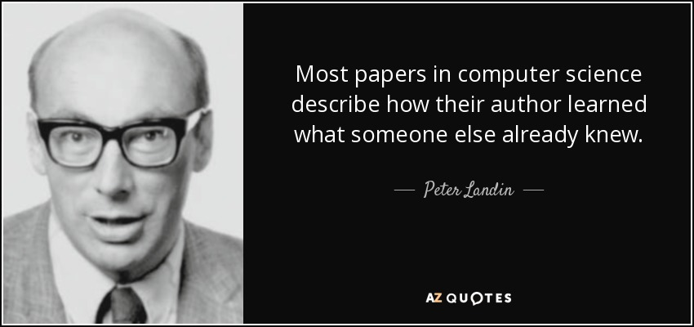
λ-Calculus
1936: American mathematician Alonzo Church invented the λ‑calculus, a formal system for describing functions.
Church had been Turing’s supervisor
1965: British computer scientist Peter Landin discovered that programming languages could be transformed into λ‑calculus
implying that the λ‑calculus itself can serve as a programming language.
Equivalent to Turing machine
Foundation of functional programming
Alonzo Church (1903.6.14 – 1995.8.11)
Peter Landin (1930.6.5 – 2009.6.3)

Slide 8
Programming Paradigms
Imperative
Assembler programming
Low level, one step up from machine code ASM, …
Procedural programming
Focus on describing how to solve a problem Pascal, Cobol, …
Object-oriented programming
Focus on structuring problems with a view to real-world objects Java, C++, …
Declarative
Logic programming
defines a set of rules and facts, queries used to solve problems Prolog, …
Functional programming
Reusing a set of functions through function calls Haskell, F#…
Notes:
Imperative describes actions to be performed
Assembler: low level; instruction set specific, processor ‘actions’
Procedural: step by step instructions
Objects: objects and classes with methods attached to objects, encapsulation, high resuabiolity
Declarative stating results rather than how to obtain; common in expert systems and AI
Logic: set of rules and facts
Functional: functions

Slide 9
Programming Language Paradigms
Imperative
Procedural
Object-oriented
Functional
Logic Programming
OpenGL (library)
Imperative
Procedural
C++(≥C++11), Python
Imperative
Procedural
Object-Oriented
Functional
Java(≥8)
Imperative
Object-Oriented
Functional
C
Imperative
Procedural

Slide 10
Logic Programming: simple example
Logic Programming
Maths: Relations
A Prolog example
https://swish.swi-prolog.org/
Code
likes(fred,beer).
likes(fred,cheap_cigars).
likes(fred,monday_night_football).
likes(sue,jogging).
likes(sue,yogurt).
likes(sue,bicycling).
likes(sue,amy_goodman).
likes(mary,jogging).
likes(mary,yogurt).
likes(mary,bicycling).
likes(mary,rush_limbaugh).
health_freak(X) :-
likes(X,yogurt),
likes(X,jogging).

Slide 11
Functional Programming
Treat a program as interaction of functions
Based on λ-calculus
Features
Functions are first-class citizens
Functions have no side-effects
Immutability - no variables, no loops
Pros
Ease to test and debug
Suitable for parallel computing
Cons
Low efficiency
Difficult to understand
A good complement to imperative and object-oriented paradigms

Slide 12
Example
Sum from 1 to 10
No loops in pure functional programming
Using recursion to achieve looping
1 int tot = 0;
2 for (int i = 1; i <10; i++)
3 tot = tot + i;
1 my_sum :: Int -> Int -> Int
2 my_sum i tot
| i > 10 = tot
4 | otherwise = my_sum (i + 1) (tot + i)
C, C++, Java, C#
Haskell
Notes:
-- SumFromOneToTenRecursive.hs main :: IO () main = print $ sumFrom1to10 -- compute and display the result -- | Sum of all integers from 1 to n, written by hand. sumFrom1to10 :: Int sumFrom1to10 = go 1 0 -- start at 1, carry an accumulator (initially 0) go :: Int -> Int -> Int -- go currentNumber acc go n acc | n > 10 = acc -- once we pass 10, return the accumulated total | otherwise = go (n+1) (acc + n)

Slide 13
Functional Programming Languages
Pure FP: Haskell
Strong FP
Lisp
Scheme
A Lisp Dialect
ML
SML, OCaml
Clojure
OO + FP
Python
Java
C++
Scala
Kotlin
…

Slide 14
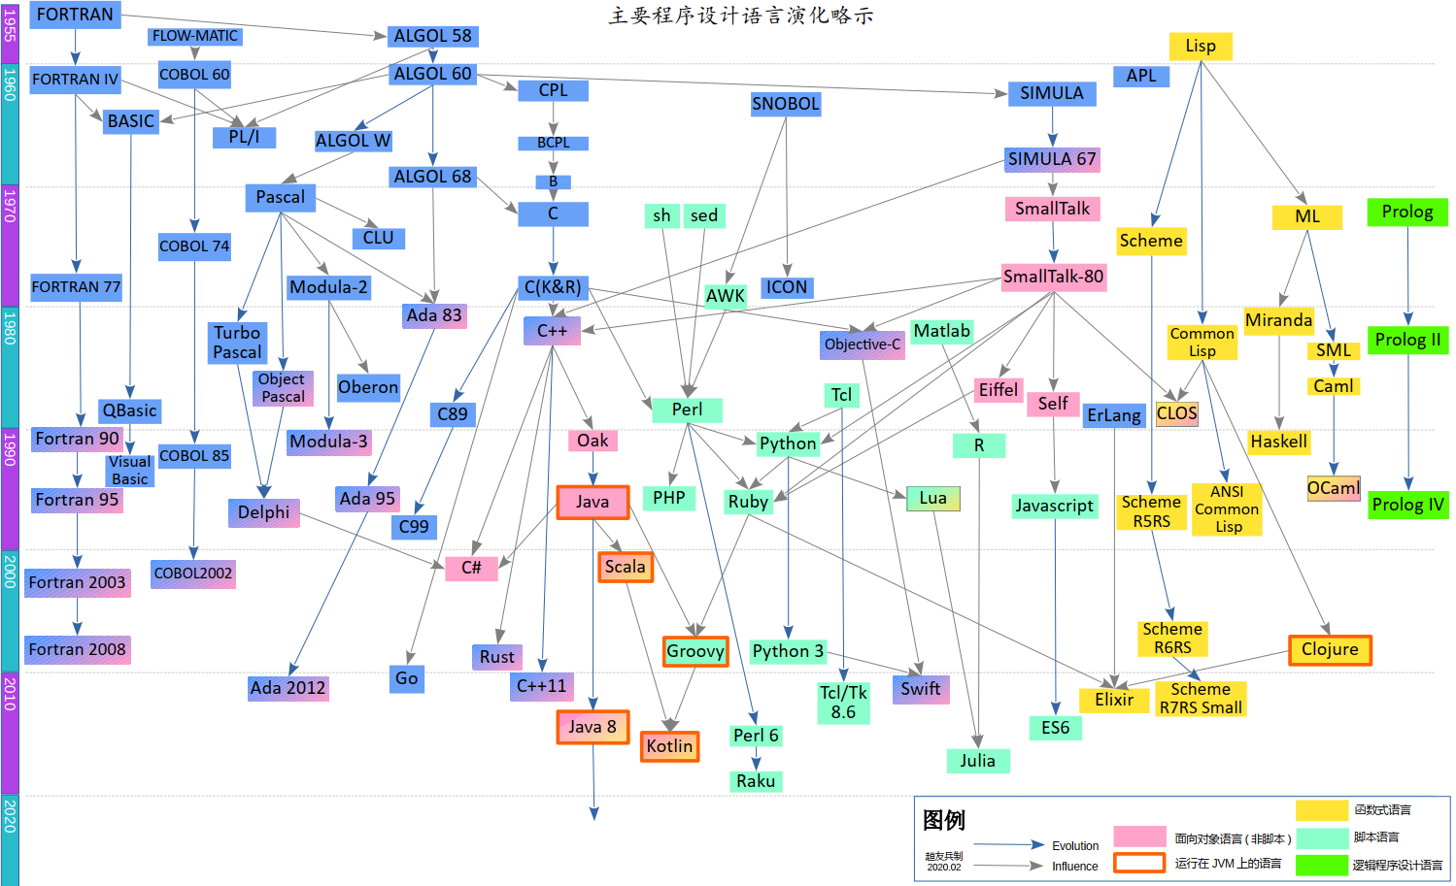
Evolution of Programming Languages till 2020
Evolution of Programming Languages

Slide 15
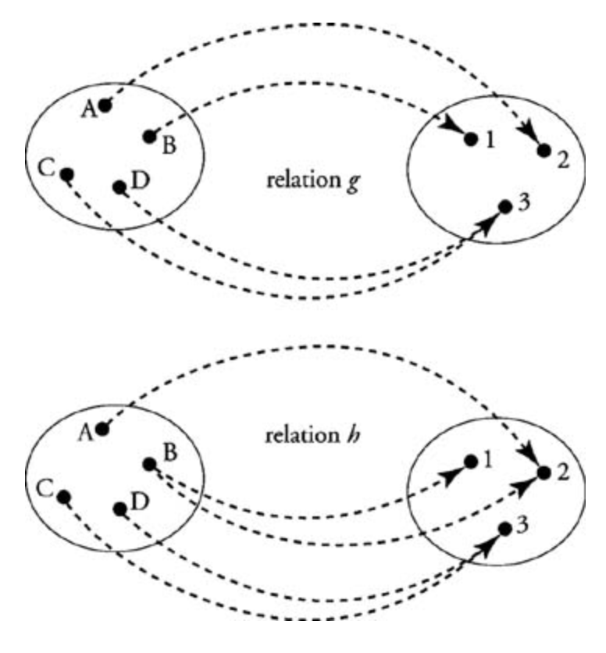
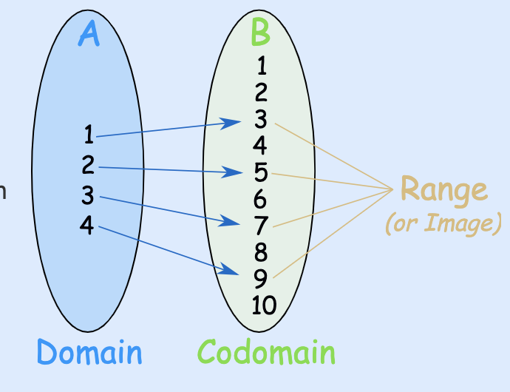
Functions - A bit of Maths
g and h are both relations
g is a function
The Domain is A, B, C, D
The Range is 1, 2, 3
The Co-domain is by definition (maybe ℕ)
Notes:
Relations map from domain to codomain, but one input can map to several outputs
Functions also map domain to co-domain but one input maps precisely to one output

Slide 16
Functional Programming
Maths: Functions
Functions are ‘first-class citizens’ in Haskell
They can be used like any other value
Focus is on evaluating expressions and not on executing instructions
Haskell is … pure
… lazy
… statically typed
Notes:
Pure
Haskell expressions are always referentially transparent
No mutation! Everything (variables, data structures…) is immutable.
Expressions never have “side effects” (like updating global variables or printing to the screen)
Calling the same function with the same arguments results in the same output every time.
Parallelism: Evaluating expressions in parallel is easy when they are guaranteed not to affect one another.
Lazy
expressions are not evaluated until their results are actually needed.
It is easy to define a new control structure just by defining a function.
It is possible to define and work with infinite data structures.
However, is that reasoning about time and space usage becomes much more complicated!
Statically typed
Every Haskell expression has a type, and types are all checked at compile-time. Programs with type errors will not even compile, much less run.

Slide 17
An example
We will understand this later, but for now let's just have a look:
Imperative programming:
int acc = 0;
for ( int i = 0; i < lst.length; i++ ) {
acc = acc + 4 * lst[i];
}
In Haskell:
sum (map (4*) lst)
Notes:
Calculating sum of list after multiplying each value by 4.
You will learn that we can solve problems with less worry about the control structures

Slide 18
Some functions and working through in steps
double x = x + x
double (double (x))
2 ways to evaluate …

Slide 19
GHCi
Starting GHCi and getting a first programme to run
GHCi test.hs
:reload
:load name
:type expr
:quit
Convention: Haskell scripts have filenames ending in .hs

Slide 20
Conventions
Names of functions and arguments start with lower case letter
You can then have digits, upper or lower case letters, underscores
There are keywords which cannot be names of functions or arguments
case, class, data, default, deriving, do, else, foreign, if, import, in, infix, infixl, infixr, instance, let, module, newtype, of, then, type, where
Layout rule: definition at same level must be at same indentation
Avoid using tabs as editors use different conventions
Enclose multiline interactive code within :{ and :} in GHCi
Comments:
-- this is a single line comment
{- this is a possible multiline comment -}

Slide 21
Some functions and working through in steps
sum [1..n]
This uses 2 library functions:
[..] which produces the list of numbers between 1 and n
[1..n] = [1, 2, 3, 4 ,5]
sum which takes a list and adds its members
sum [1, 2, 3, 4, 5] = 1 + 2 + 3 + 4 + 5
Sum is defined with 2 equations
Sum [] = 0
Sum (n:ns) = n + sum ns
Sum has a type of Num a => [a] -> a

Slide 22
An exercise for you
Define a function that produces the product of a list of numbers, and show that [2, 3, 4] = 24

Slide 23
This week we looked at some basic functions Next week we will look at types and classes before then moving on to defining functions

